Slide 1

C POINTERS
BY-ANUJRAJ MOHAPATRA

Slide 2

What are Pointers?
A pointer is a variable whose value is the address of another variable, i.e., direct address of the memory location. Like any variable or constant, you must declare a pointer before using it to store any variable address.
The general form of a pointer variable declaration is −
type *var_name;

Slide 3
Why pointers?
Pointers save memory space.
Execution time with pointers is faster because data are manipulated with the address, that is, direct access to memory location.
Memory is accessed efficiently with the pointers. The pointer assigns and releases the memory as well. Hence it can be said the Memory of pointers is dynamically allocated.
Pointers are used with data structures. They are useful for representing two-dimensional and multi-dimensional arrays.
An array, of any type, can be accessed with the help of pointers, without considering its subscript range.

Slide 4
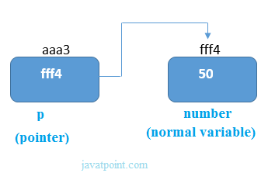
Pointer Example
An example of using pointers to print the address and value is given below.
As you can see in the above figure, pointer variable stores the address of number variable, i.e., fff4. The value of number variable is 50. But the address of pointer variable p is aaa3.
By the help of * (indirection operator), we can print the value of pointer variable p.

Slide 5

Examples
Pointer to array:
int arr[10];
int *p[10]=&arr; // Variable p of type pointer is pointing to the address of an integer array arr.
Pointer to a function:
void show (int);
void(*p)(int) = &display; // Pointer p is pointing to the address of a function
Pointer to structure:
struct st {
int i;
float f;
}ref;
struct st *p = &ref;

Slide 6
Usage of pointer
There are many applications of pointers in c language.
1) Dynamic memory allocation
In c language, we can dynamically allocate memory using malloc() and calloc() functions where the pointer is used.
2) Arrays, Functions, and Structures
Pointers in c language are widely used in arrays, functions, and structures. It reduces the code and improves the performance.

Slide 7
NULL Pointer
A pointer that is not assigned any value but NULL is known as the NULL pointer. If you don't have any address to be specified in the pointer at the time of declaration, you can assign NULL value. It will provide a better approach.
int *p=NULL;

Slide 8

THANK YOU

